Slide 1

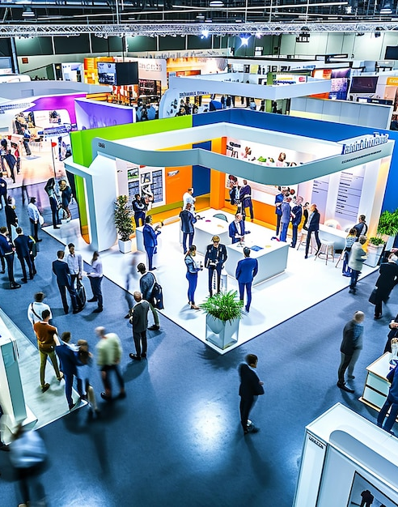
Presentation
EXHIBITION STANDS
INSPIRATION
LOOK BOOK
www.solutionsgroup.co.za

Slide 2
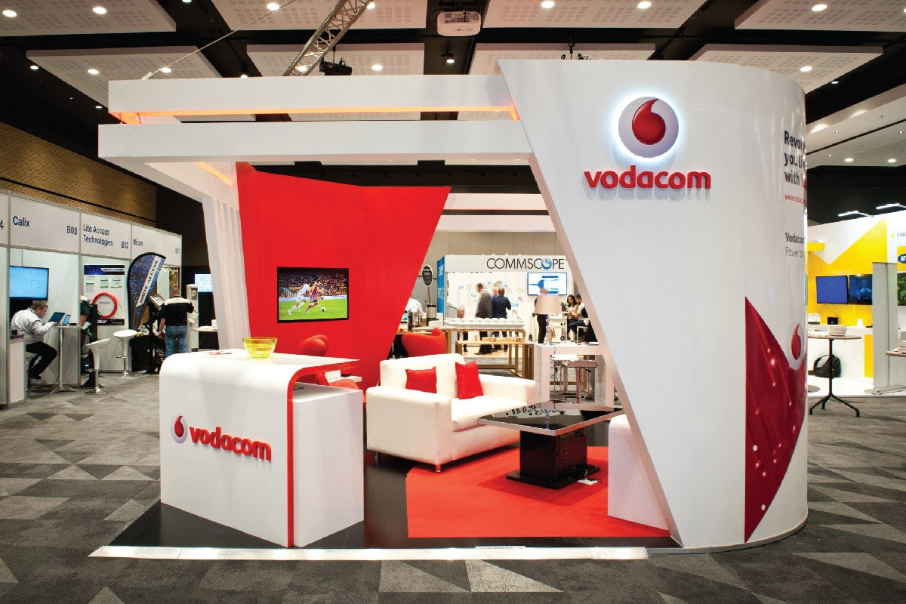
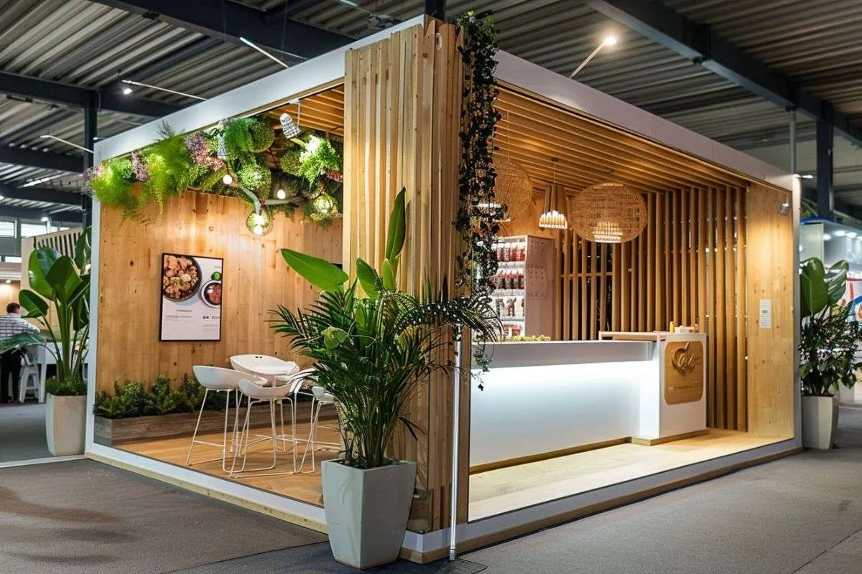
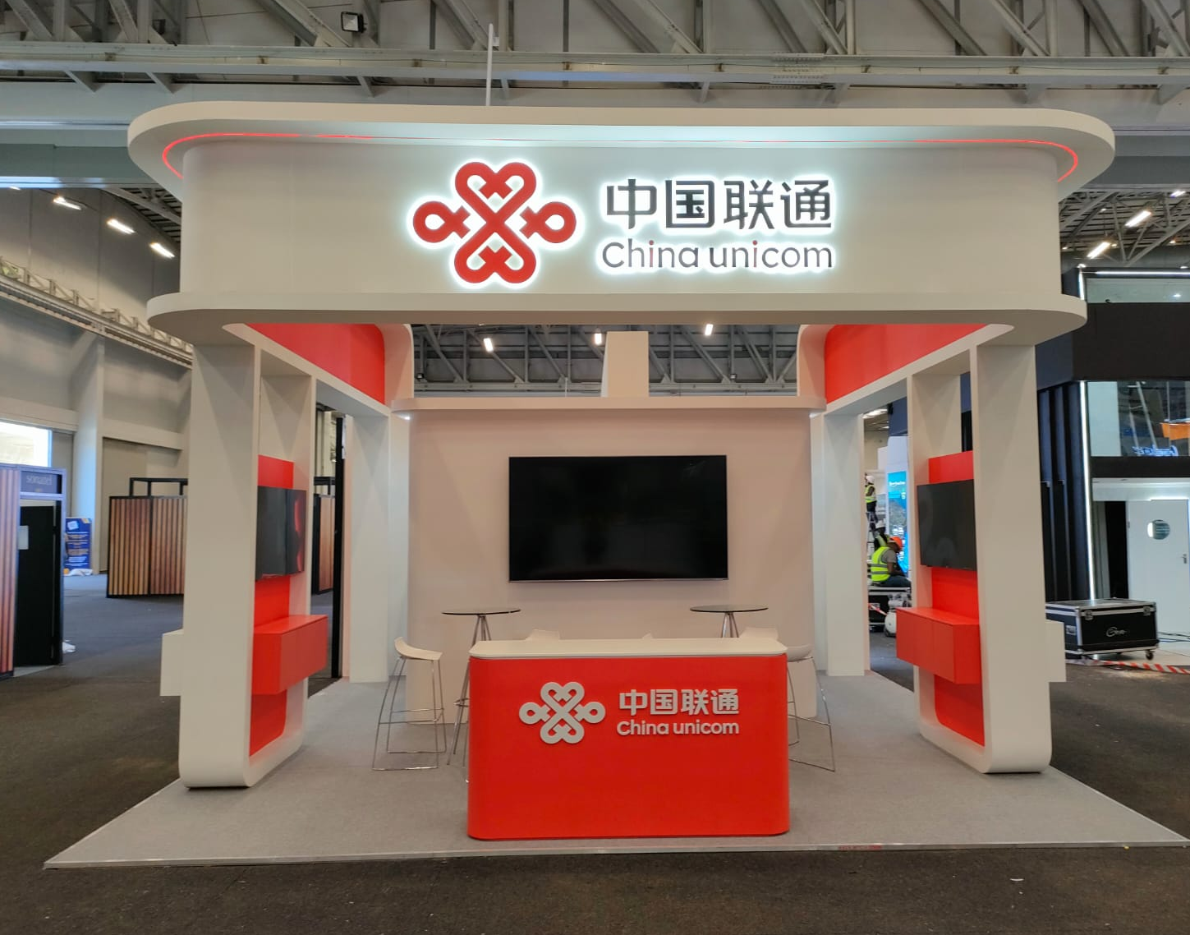

EXHIBITION STANDS
We specialize in creating impactful exhibition stands that captivate audiences and elevate your brand presence, both nationally and across Africa.
From concept to on-site installation, we offer end-to-end solutions, including interactive displays and tailored branding, ensuring a seamless and impactful exhibition experience that captivates your audience and elevates your brand presence.
Our team of expert exhibition architects, graphic designers, and project managers will work closely with you, ensuring every detail aligns with your goals, offering tailored branding, logistics, and technical support to deliver a seamless and memorable exhibition experience

Slide 3

EXHIBITION STANDS TYPES
Custom-built stands:
Fully bespoke designs tailored to your brand and event goals, offering maximum creativity and uniqueness.
Modular stands:
Versatile, reusable stands made from pre-designed components, allowing for easy customization and adaptability.
Portable stands:
Lightweight, easy-to-assemble stands such as pop-up displays, banner stands, and roll-ups, perfect for smaller events or travel.
Shell scheme stands:
Standardized booth structures often provided by event organizers, which can be customized with graphics and displays.
Double-decker stands:
Multi-level stands offering additional space for product displays, meetings, or private discussions, ideal for larger events.
Island stands:
  Free-standing displays accessible from all sides, perfect for creating a central, high-visibility hub.
Peninsula stands:
Three-sided open displays, offering greater visibility while allowing for more creative design and traffic flow.
Pop-up shops:
Temporary retail-style stands designed to engage customers with product demonstrations or direct sales.

Slide 4
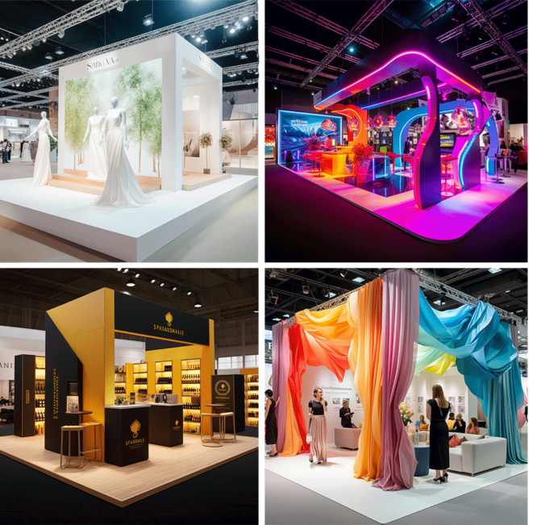
CUSTOM
STAND
EXAMPLES

Slide 5

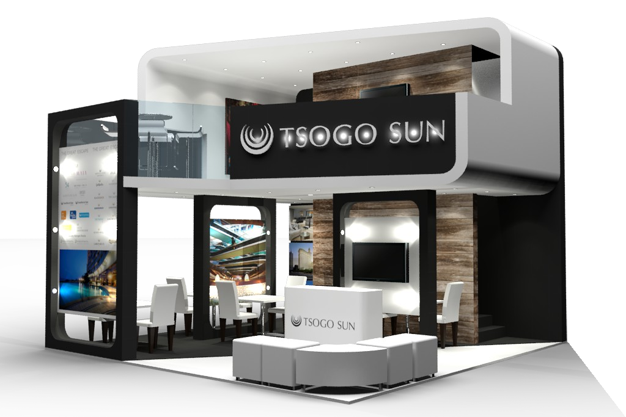
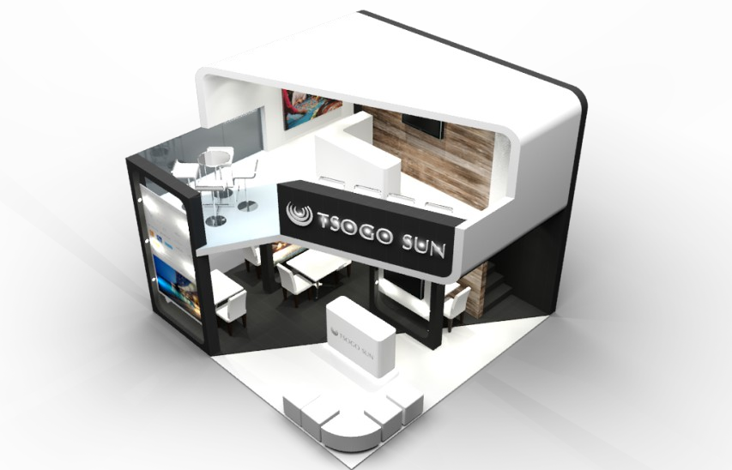
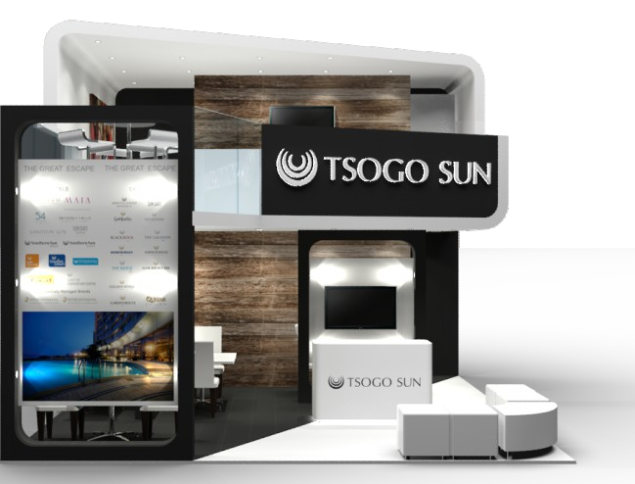
CUSTOM-BUILD STANDS

Slide 6
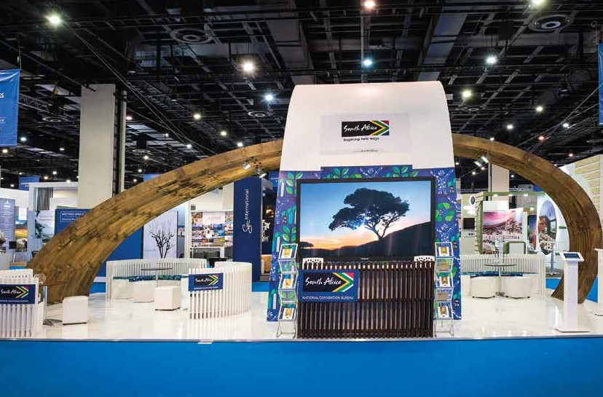
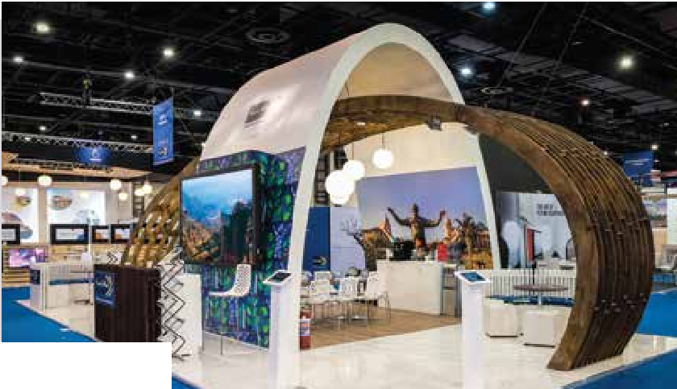

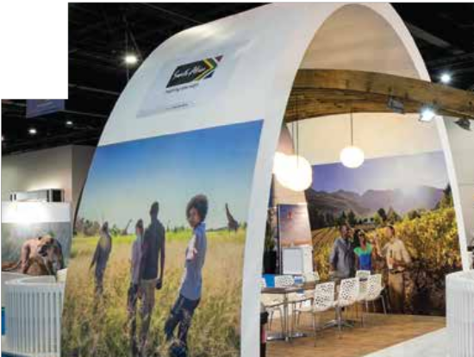
CUSTOM-BUILD STANDS

Slide 7
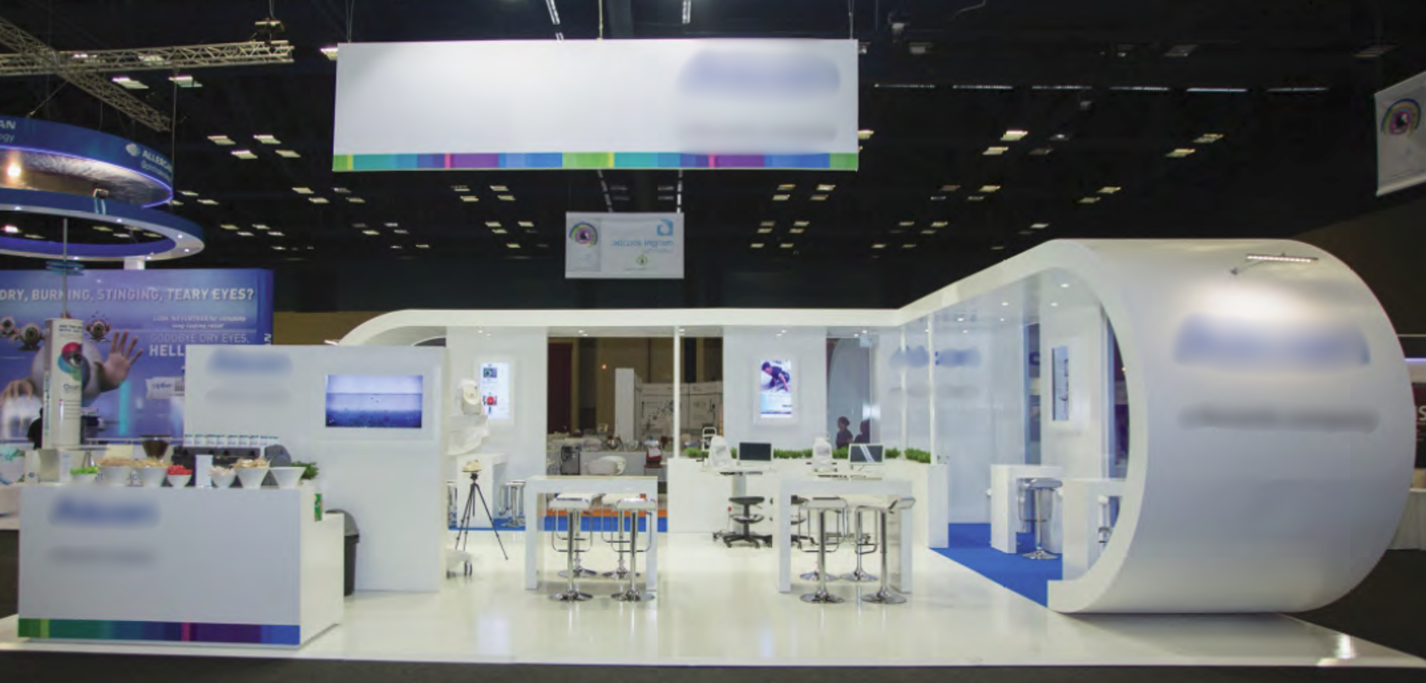
CUSTOM-BUILD STANDS

Slide 8
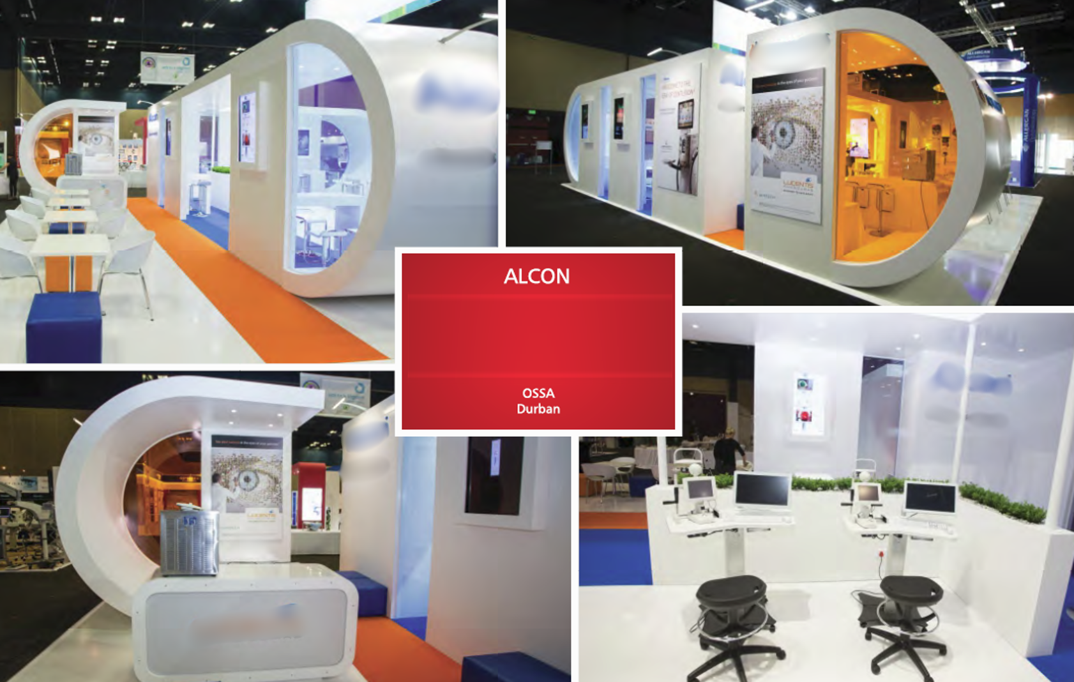
CUSTOM-BUILD STANDS

Slide 9
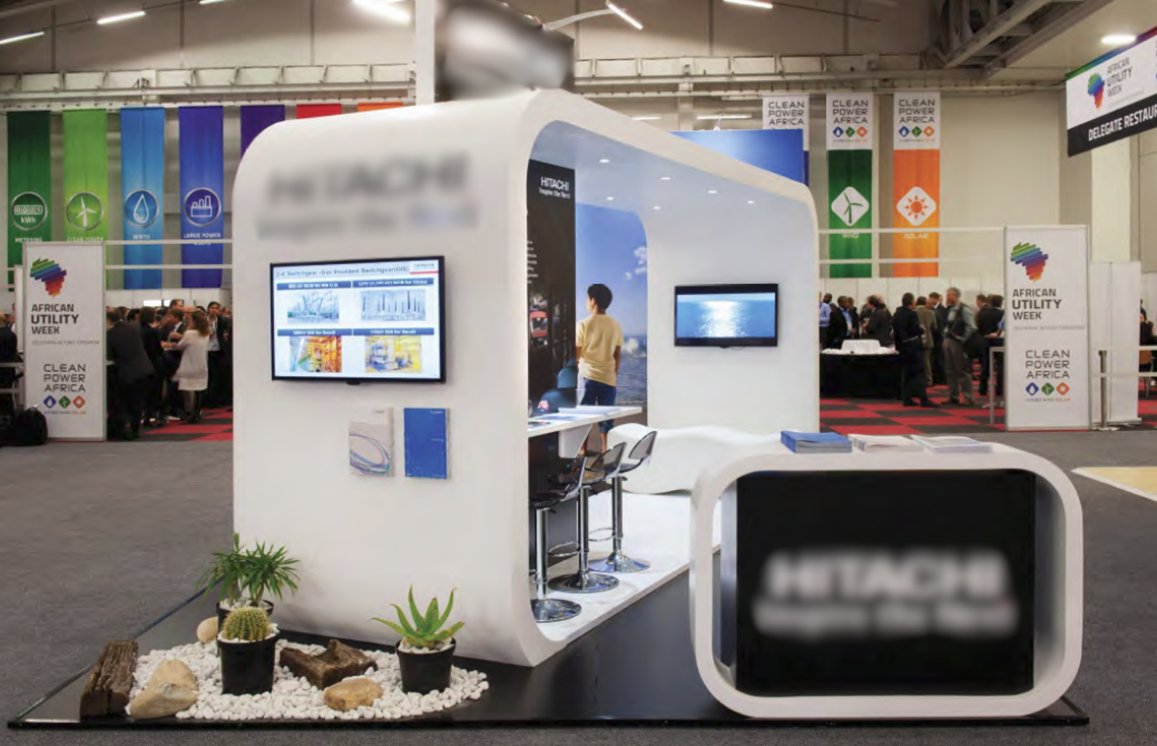
CUSTOM-BUILD STANDS

Slide 10
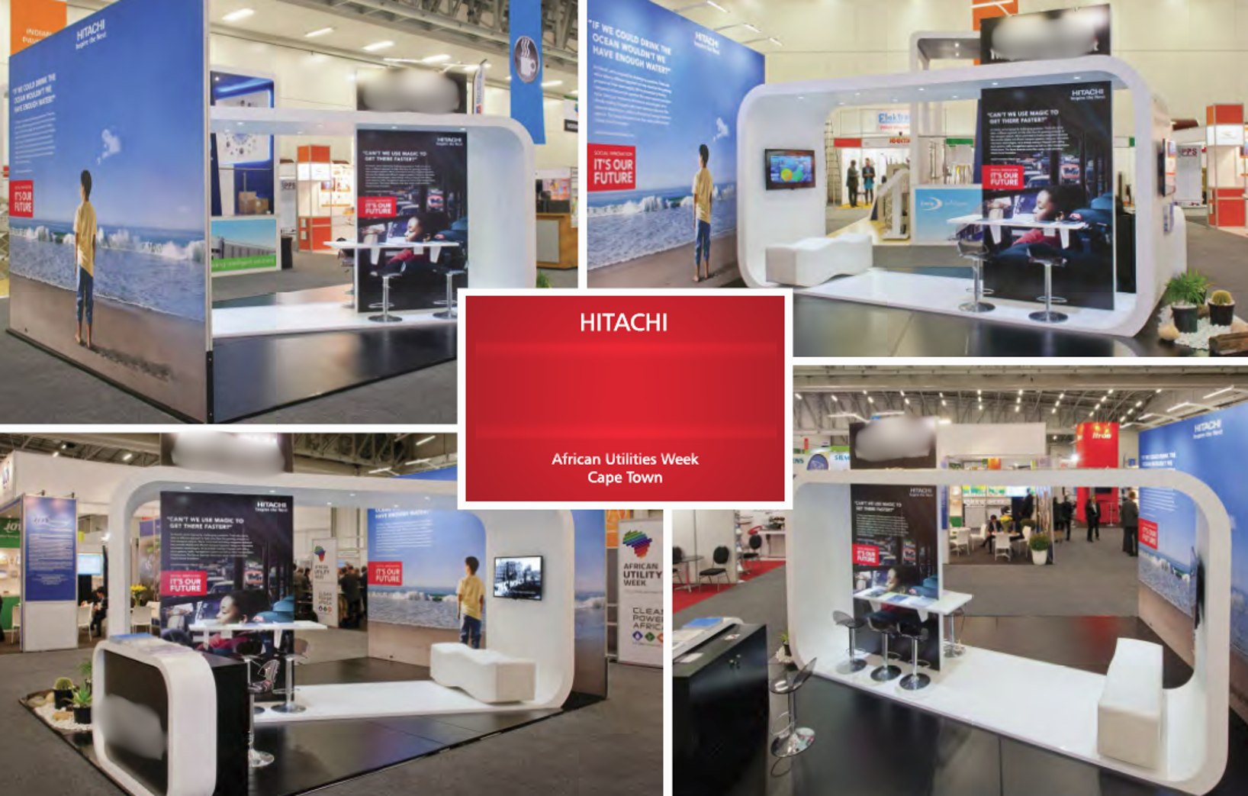
CUSTOM-BUILD STANDS

Slide 11

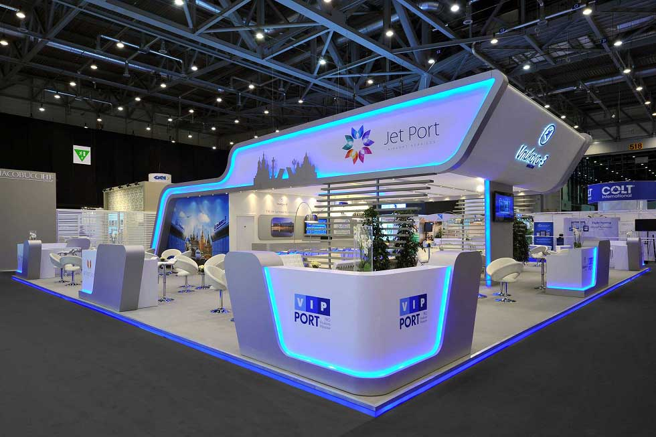
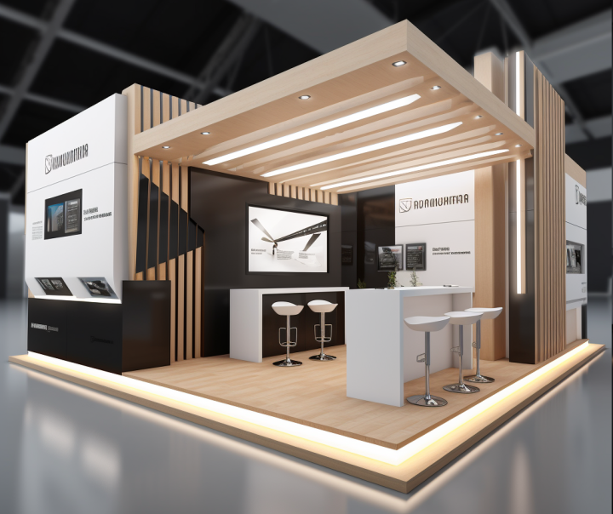
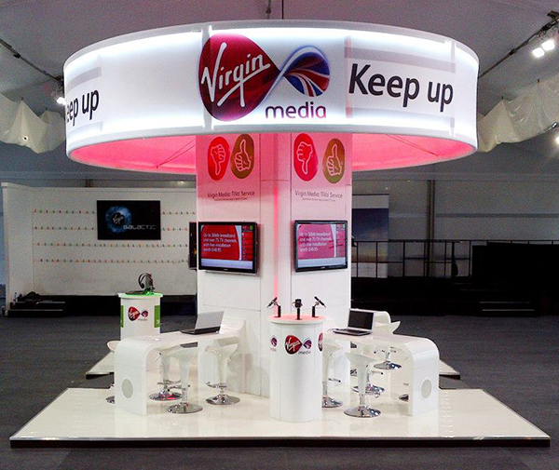
CUSTOM-BUILD STANDS

Slide 12
SMALL STANDS

Slide 13
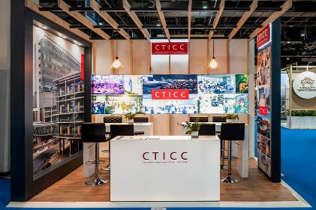
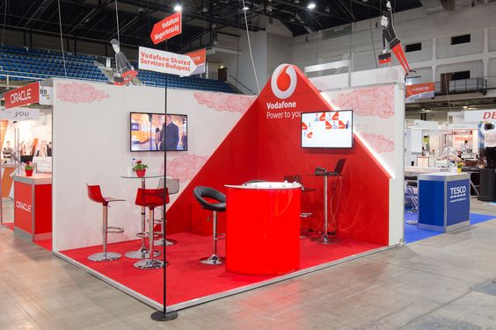
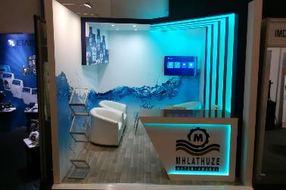
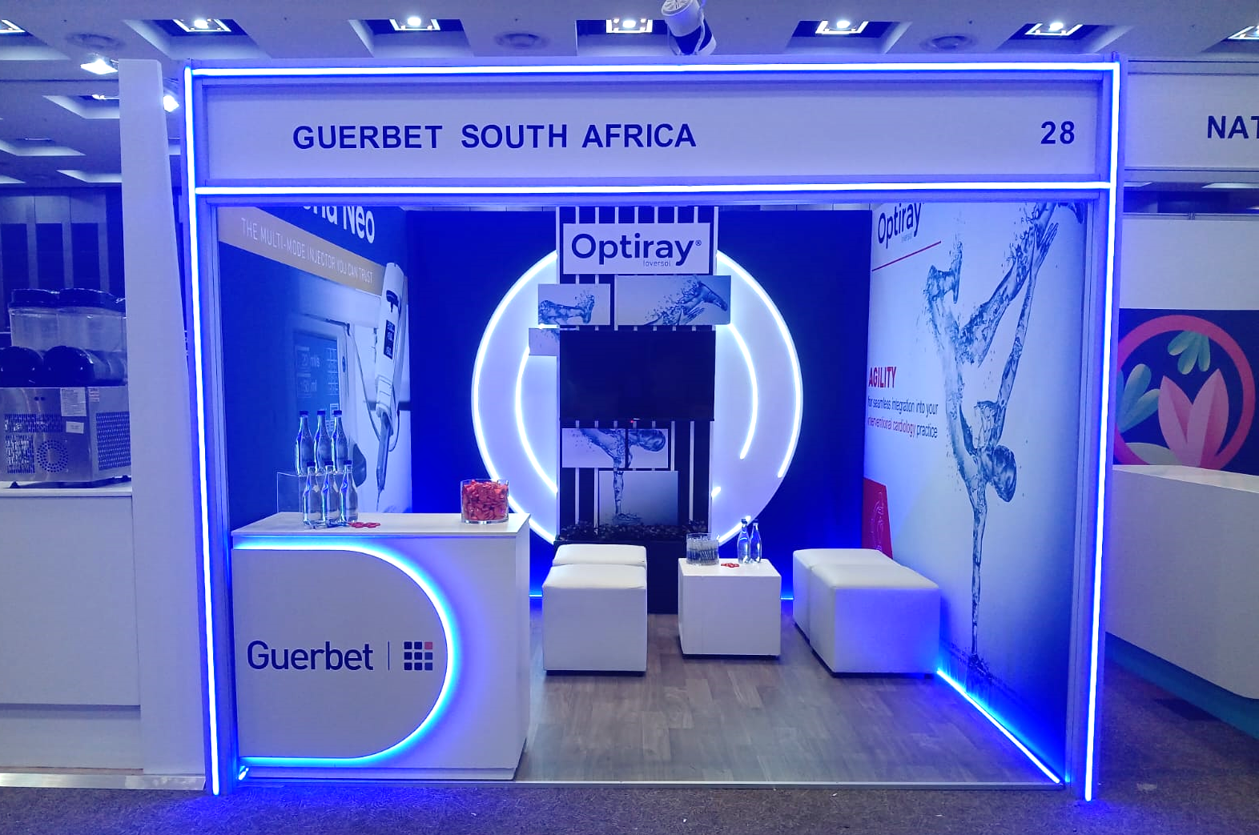
SMALL STANDS

Slide 14
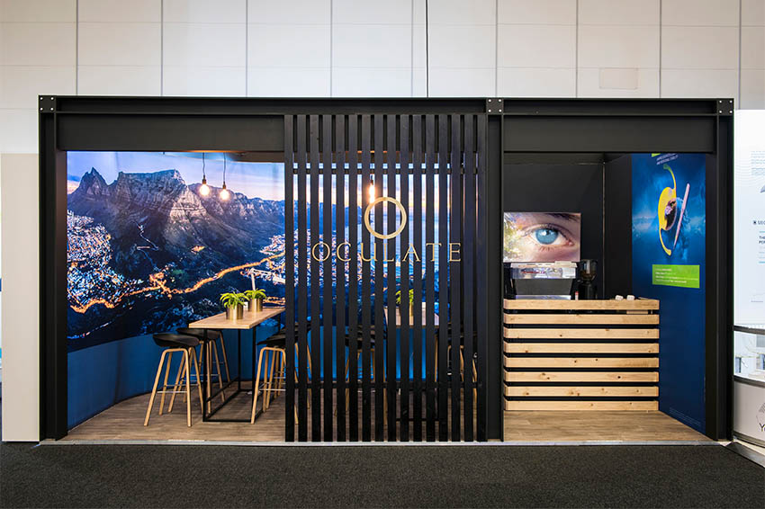
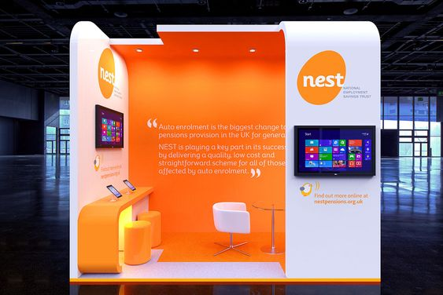
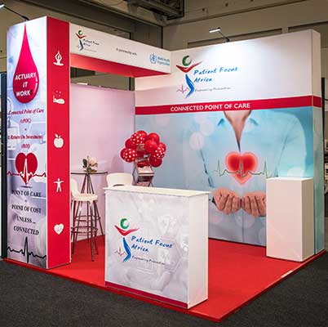
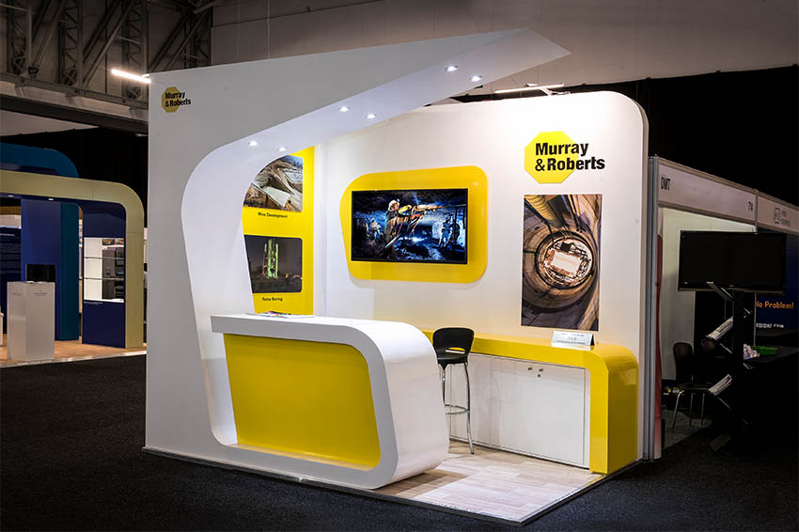
SMALL STANDS

Slide 15
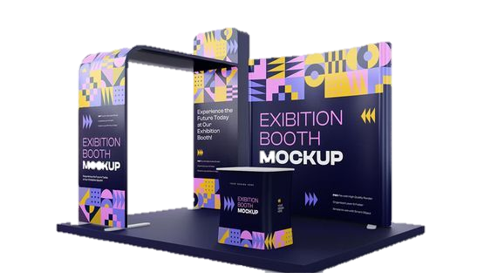
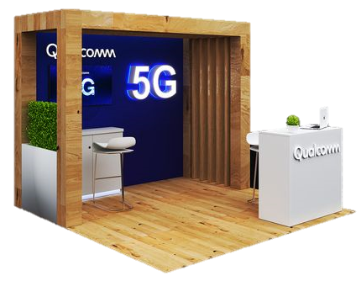
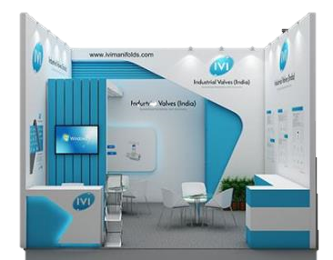
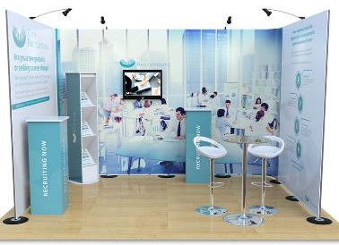
SMALL STANDS

Slide 16


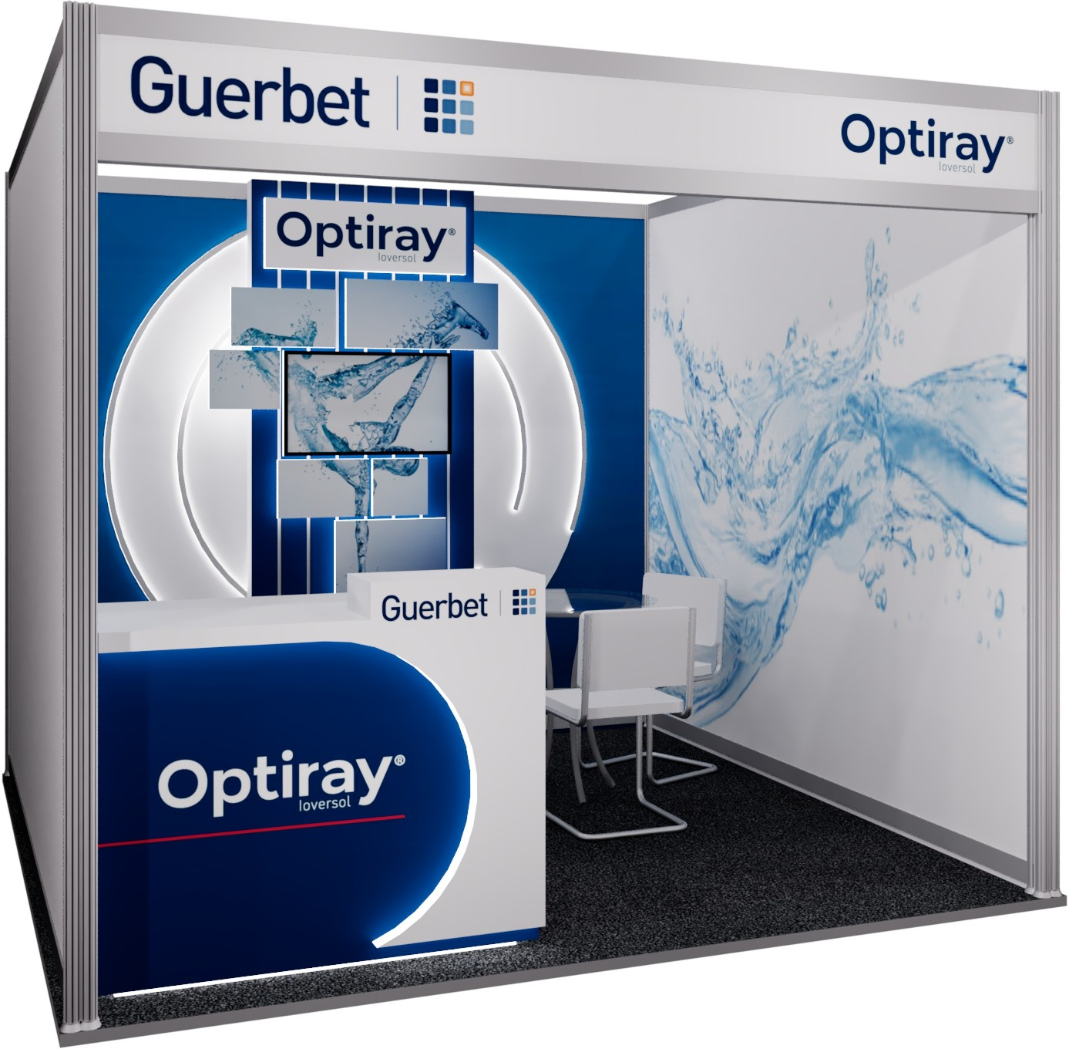
SMALL STANDS

Slide 17
ELEMENTS

Slide 18
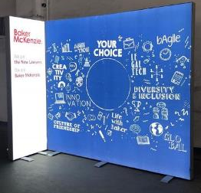
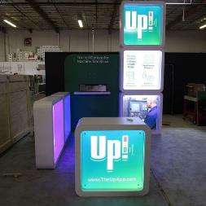
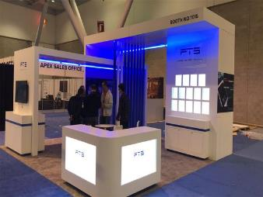
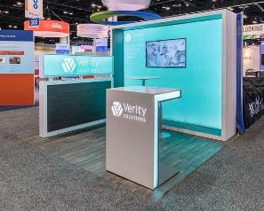
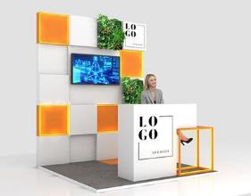
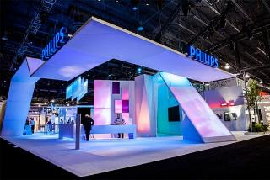
Our Team
LIGHTING EFFECTS
Backlit fabric print
LED Light Boxes
Signature colour lighting
Backlit fabric print
3D Light Boxes
Coloured lighting wash

Slide 19
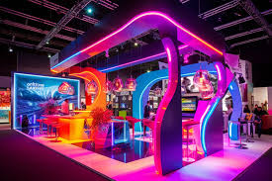
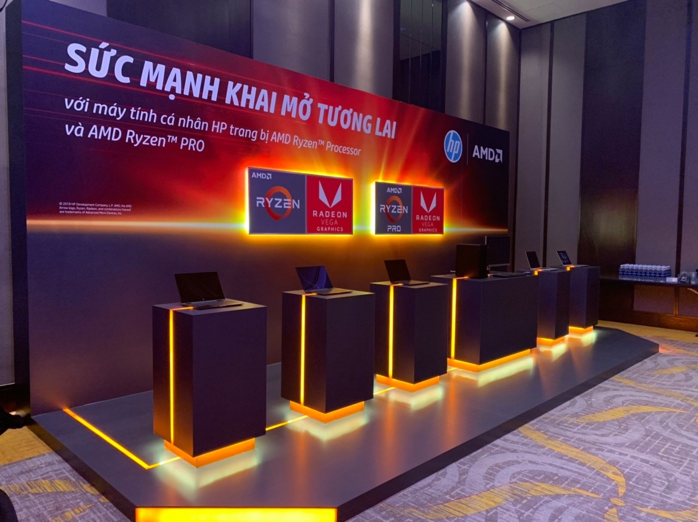
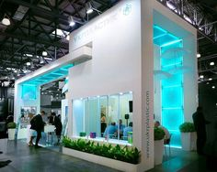
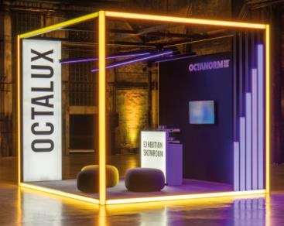
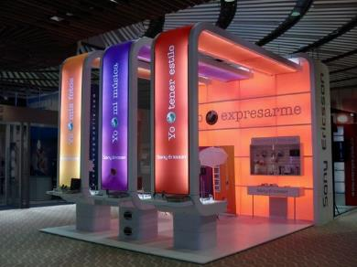
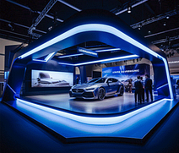
LIGHTING EFFECTS

Slide 20

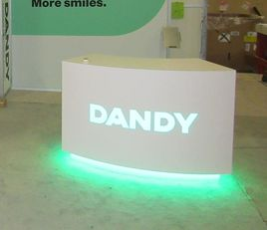
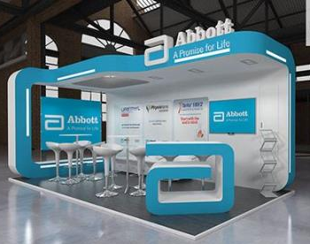
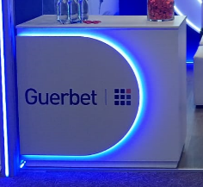

CUSTOMISED COUNTERS
Custom Shape & Colour
Lighting Effects
Monogram or Logo shaped counter

Slide 21
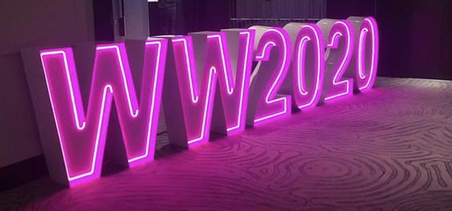
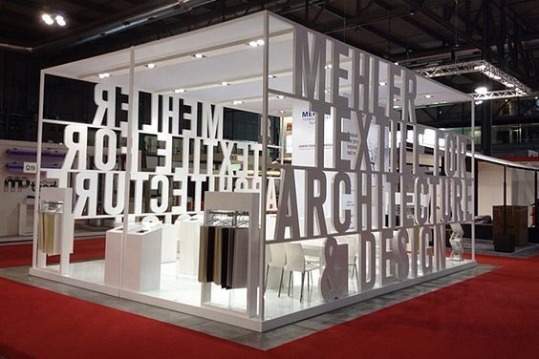
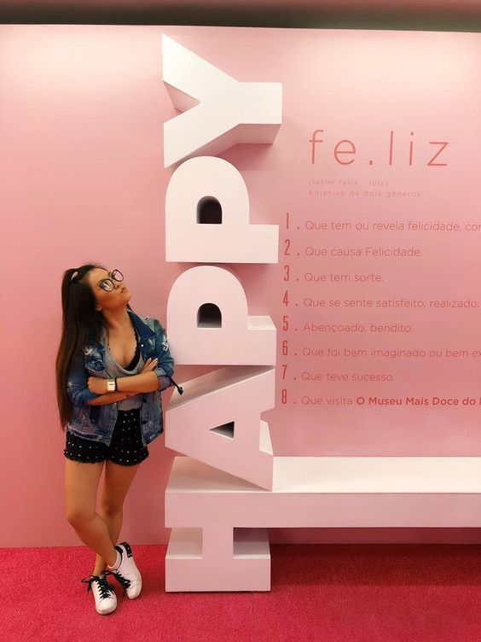
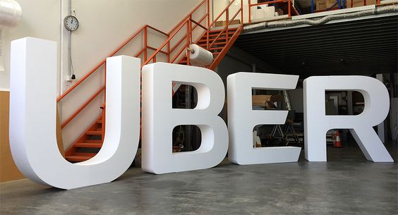


FREE STANDING LETTERING

Slide 22





FEATURE OR FEATURE WALLS

Slide 23



UNIQUE PHOTO OPPORTUNITIES

